Slide 1
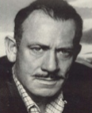
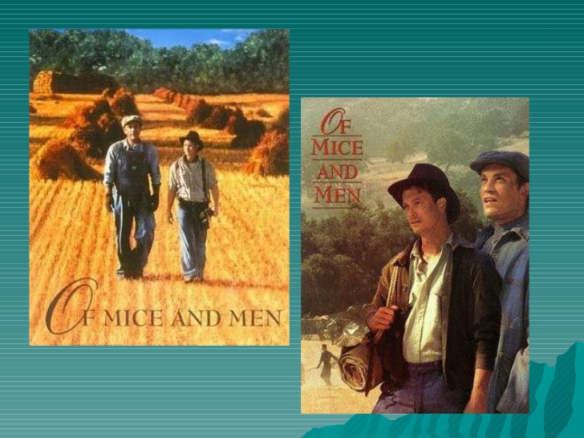
Welcome to the
Of Mice And Men
Literature
Forum!

Slide 2

How does this forum work?
- Take notes
- Communicate with each other
- Participate!
We will be walking around and asking people to share their answers with the group-Be ready!

Slide 3
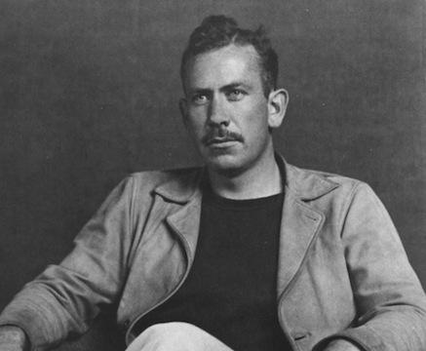
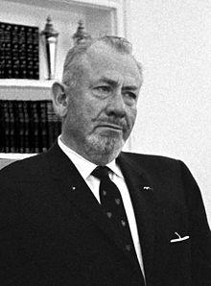
Author: John Steinbeck and
His Background
-Steinbeck was born in 1902.
-He loved reading and writing at the age of 14.
-He attended Stanford University.
-He worked on California ranches with migrant workers.
-Of Mice And Men was published in 1936.

Slide 4
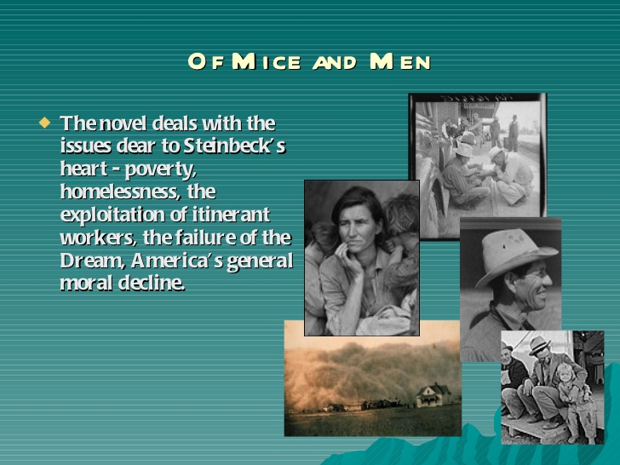
Setting of the novel

Slide 5
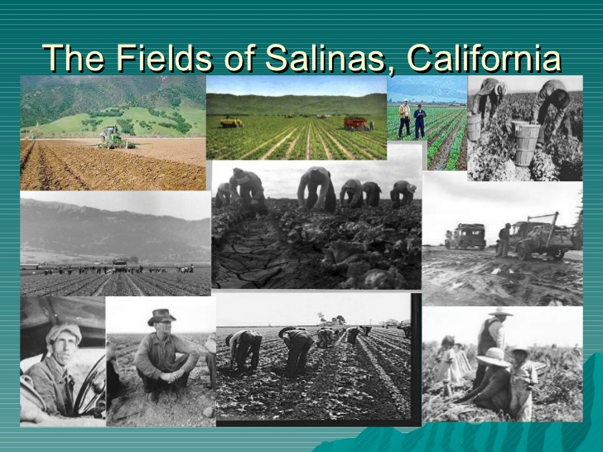
The novel is set in Salinas Valley, where John Steinbeck was born.

Slide 6
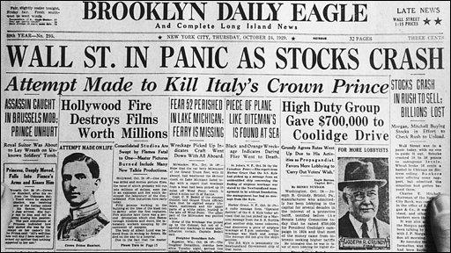
The Great Depression...
What the heck does it have to do with this book?
Question and Answer!! Look at your note sheet and talk with your partner. Come up with an answer to the following questions!
  What was the Great Depression? When did it happen?
  What caused the Great Depression?

Slide 7
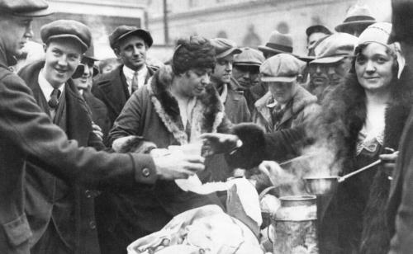
What was the Great Depression?
The Great Depression (1929-39) was the longest-lasting economic downturn in the history of the U.S.
In the United States, the Great Depression began soon after the stock market crash of October 1929.
Over the next several years, consumer spending and investment dropped, causing steep declines in industrial output and rising levels of unemployment as failing companies laid off workers.

Slide 8
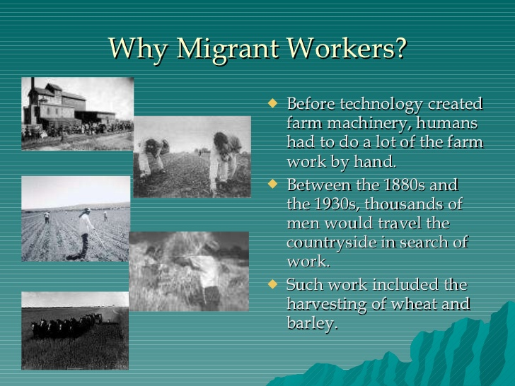

Slide 9
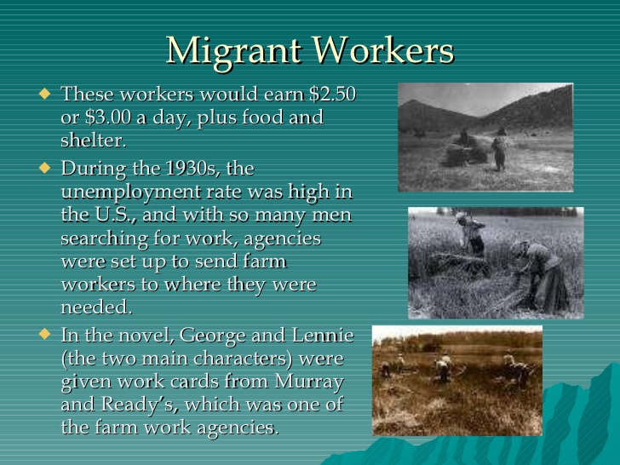

Slide 10
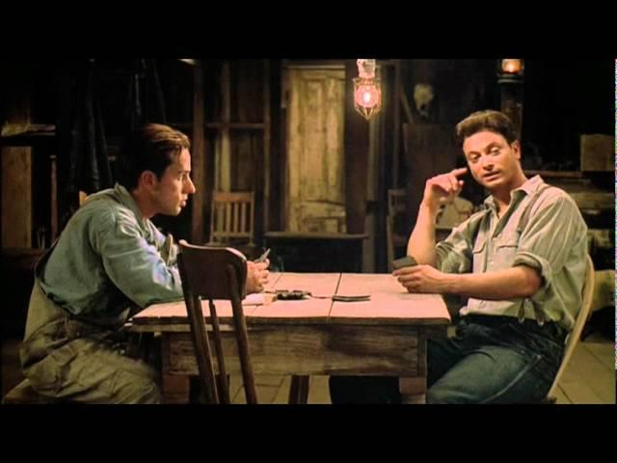
Of Mice And Men Trailer

Slide 11


The novel has 3 main themes that we will explore.
The American Dream
Discrimination/Racism
Friendship/Loneliness

Slide 12


Theme 1: The American Dream

Slide 13

Why do people come to America today?
Brainstorm with your partner!

Slide 14

Here are some ideas!
-freedom
-better jobs
-education
-home ownership
- opportunity

Slide 15
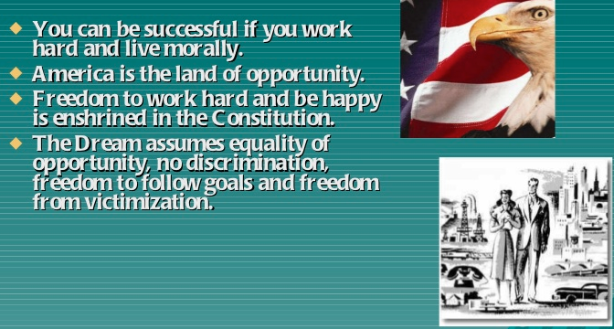
American Dream

Slide 16
Polleverywhere.com
What percentage of Americans do you think achieve the American Dream?
Notes:
<?xml version="1.0" encoding="ISO-8859-1" ?>
<poll url="http://www.polleverywhere.com/multiple_choice_polls/uUDktVNXLqCtDMk">
<!-- This snippet was inserted via the PollEv Presenter app -->
<!-- The presence of this snippet is used to indicate that a poll will be shown during the slideshow -->
<!-- TIP: You can draw a solid, filled rectangle on your slide and the PollEv Presenter will automatically display your poll in that area. -->
<!-- The PollEv Presenter app must also be running and logged in for this to work. -->
<!-- To remove this, simply delete it from the notes yourself or use the PollEv Presenter to remove it for you. -->
<title>What percentage of Americans achieve the "American Dream?"</title>
</poll>

Slide 17

While listening to the song “America,” by Neil Diamond, write down what you think the song means, stanza by stanza. Share your thoughts with your partner. You will be asked to share with the forum!

Slide 18
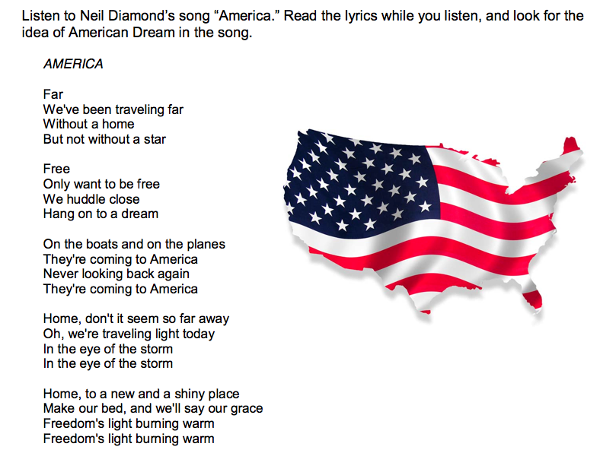



American Dream
Neil Diamond- America

Slide 19
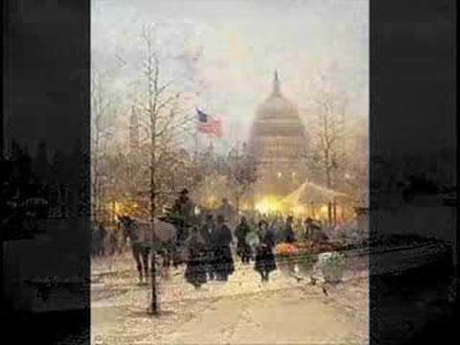
Neil Diamond’s song America

Slide 20

What is the meaning of the song?
The song is a tribute to immigration in America. People from all over the world were welcome to seek opportunity.

Slide 21

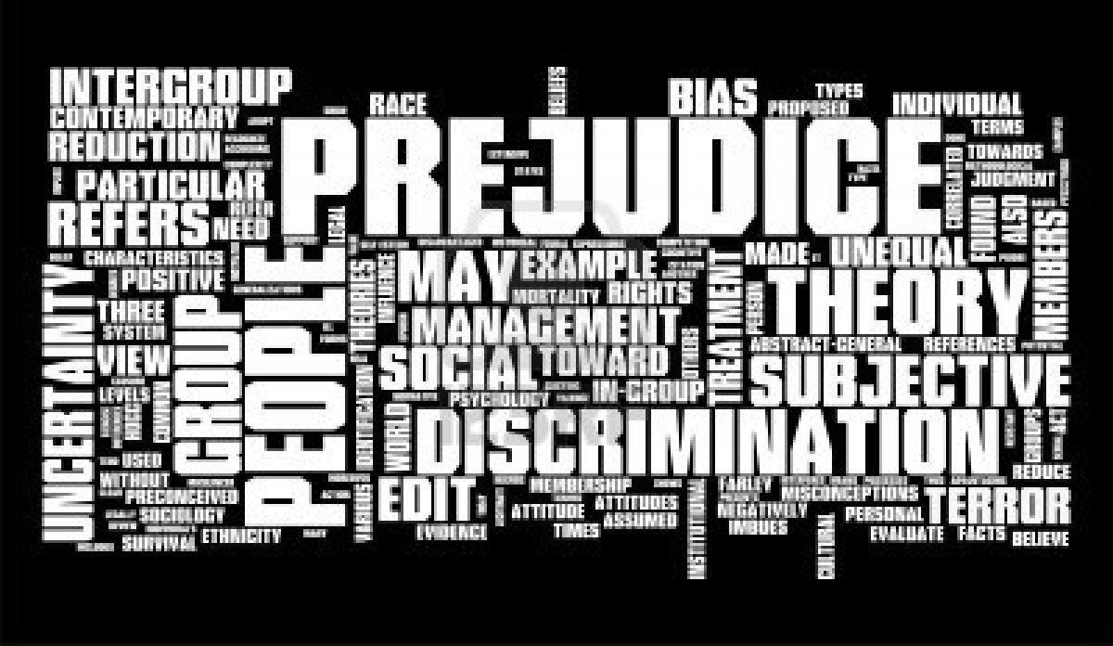
Theme 2: Prejudice

Slide 22


This book was banned!
Why?

Slide 23

Why is Steinbeck’s
Of Mice and Men
considered a controversial book?
Steinbeck's work opens doors to some of the darker issues of life — death, racism, sexism, false hopes, and the harshness of poverty.

Slide 24
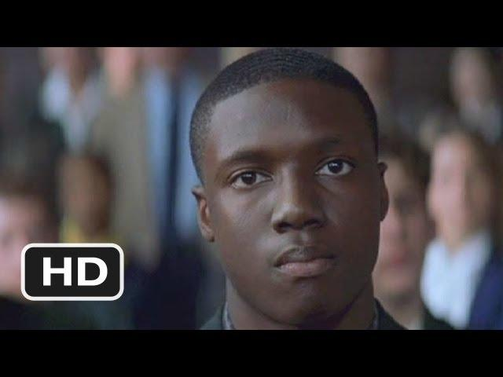
The movie Finding Forrester provides an example of discrimination and racism.

Slide 25
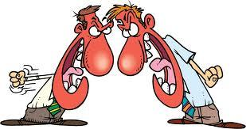
What was the conflict in the previous clip?

Slide 26

Examples of prejudice in
Of Mice And Men:
- People with disabilities (mental and physical)
- African Americans
- Women

Slide 27
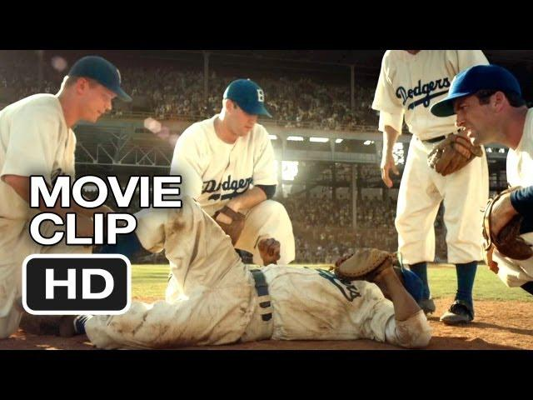
The movie 43 provides and example of prejudice/racism.

Slide 28
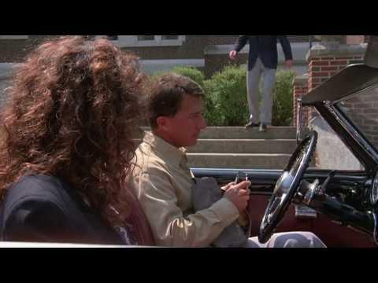
The movie Rain Man provides an example of discrimination.

Slide 29
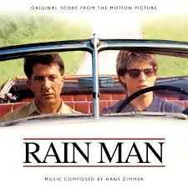
Why doesn’t Charlie grow up with his brother, Raymond?
Why is Raymond a hidden entity?
Talk with your neighbor!

Slide 30
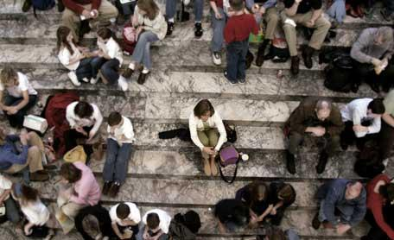
Theme 3: Friendship and Loneliness

Slide 31
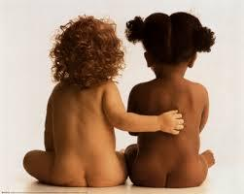
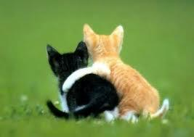
Friendship Survey
Take a moment and answer the questions provided.

Slide 32
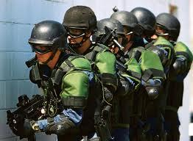

How far would you go to protect your friends/family?

Slide 33
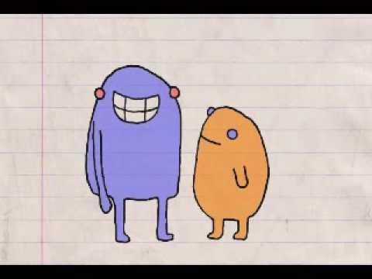
This clip is a silly example of friendship.

Slide 34
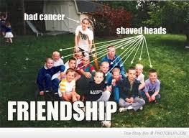

How was friendship portrayed in the previous clip?

Slide 35


Character quotes!
•Read the character quotes posted around the theater.
•Make an inference, using adjectives that would best describe each character.

